Slide 1
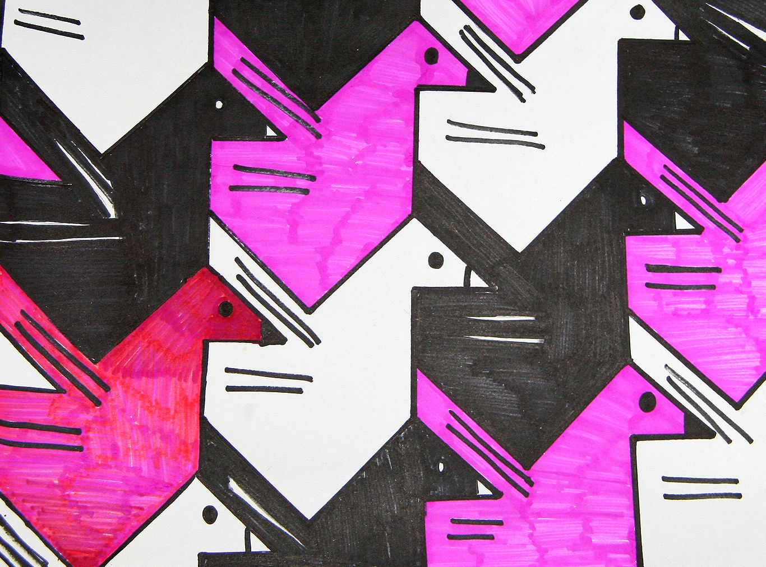
TRANSLATION TESSELLATION

Slide 2
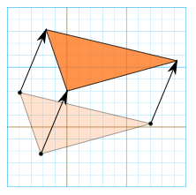
Mathematical Terms
Translation: “sliding”; moving a shape without changing its size, rotating, or flipping it. The shape will look the same, but be in a different place.
Every point of the shape must move…
The same distance
In the same direction
*For a detailed explanation of translation in mathematical terms, see this video: https://youtu.be/IQ5AZ6wbR8Q
Notes:
Before we can understand how a simple translation tessellation is created, it is important to review a few key mathematical concepts. The first is translation: this is when an object is moved in any direction, without changing its size, rotating, or flipping it. The translated shape will look the same, but be in a different place.
In the diagram here, every point of the triangle is moved the same distance and in the same direction—which you can check by comparing the coordinates of the points on the grid—in order to translate the object.

Slide 3
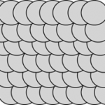
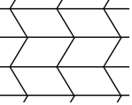
Mathematical Terms
Tessellation: a repeating pattern of shapes that can continue infinitely on a plane (e.g. a flat surface) where there are 1) no gaps or holes between shapes and 2) no overlaps between shapes. Also called “tiling.”
REVIEW: Which of the following are tessellations? Why or why not?
a)
b)
c)
d)
Notes:
We should also briefly review the term “tessellation.” A tessellation is a repeating pattern of shapes that can continue infinitely on a plane—a flat surface. This pattern must first have no gaps or holes between shapes, and second have no overlaps between shapes.
Which of the following four patterns meet are tessellations?
Answer: B and C are tessellations, A and D are not—A because there are gaps between the circles, and D because the shapes overlap.

Slide 4
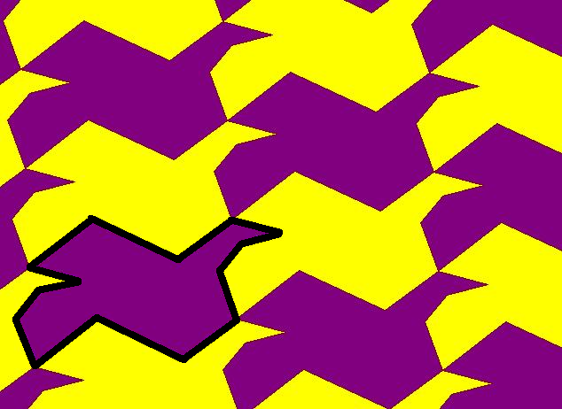
Mathematical Terms
Simple translation tessellation: a pattern with no gaps or overlaps, made by sliding a shape to repeat it.
Example: In the simple translation tessellation below, the shape outlined in black repeats within the patterns below by sliding in different directions: for example, up (L) and across (R)
Notes:
Having reviewed the terms translation and tessellation, we can now understand how simple translation tessellations are made! Firstly, a translation tessellation is a pattern with no gaps or overlaps (e.g. a tessellation), made by sliding (e.g. translating) a shape to repeat it. Here you can see how the bird shape—outlined in black—is slid up and across the surface to form the translation tessellation. Notice that the shape is never flipped or rotated as it is repeated.

Slide 5
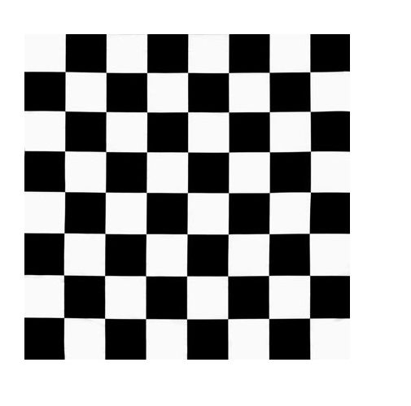
REVIEW ACTIVITY:
With your finger—if using a screen—or with a pen, outline the basic shape that is being repeated in each of the translation tessellations on the following four slides. Then draw arrows to indicate the directions in which the shapes are being translated (“slid”).
EX:
Notes:
In this activity we will practice translating shapes in tessellations! With your finger—if using a screen—or with a pen, outline the basic shape that is being repeated in each of the translation tessellations on the following four slides. Then draw arrows to indicate the directions in which the shapes are being translated (“slid”). As an example, the shape in the tessellation on this slide has been outlined, and arrows have been drawn in all directions in which the shape is being translated or “slid.”

Slide 6
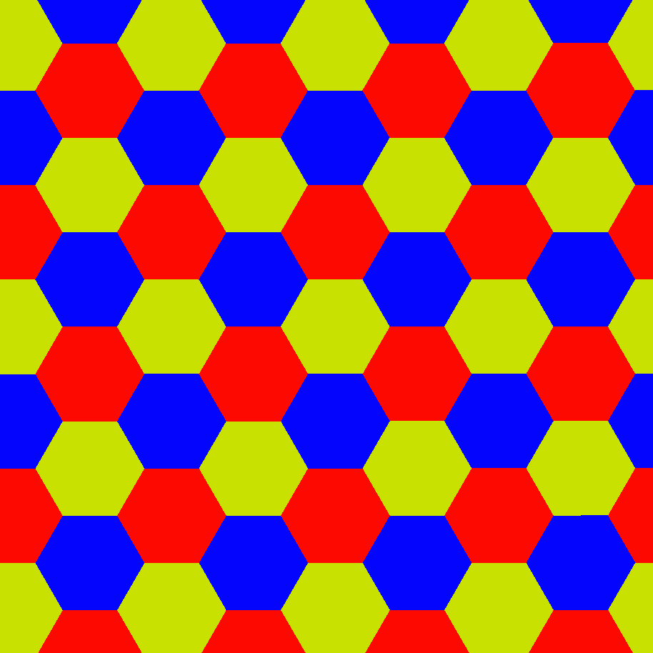
1.

Slide 7
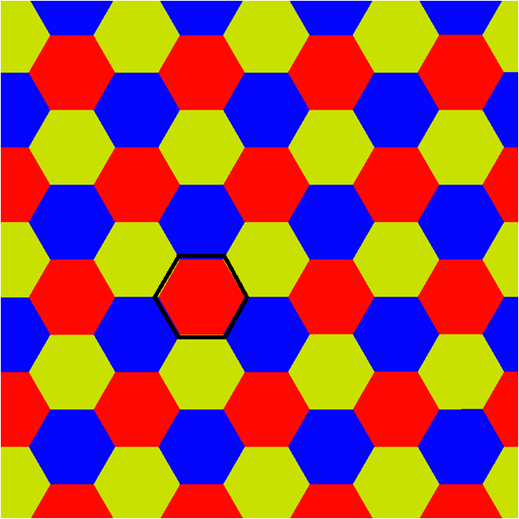
ANSWER (1)

Slide 8
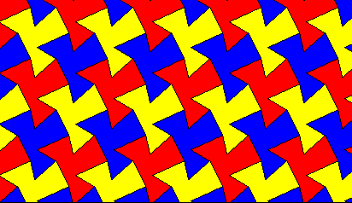
2.

Slide 9
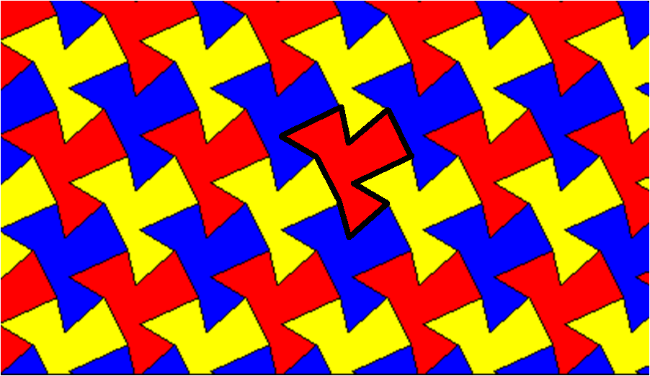
ANSWER (2)

Slide 10
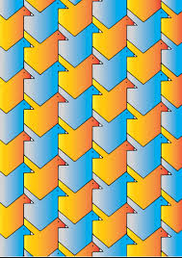
3.

Slide 11
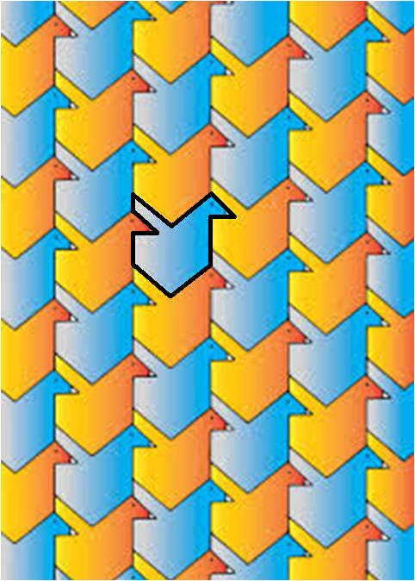
ANSWER (3)

Slide 12
4.
Flying Horses, M.C. Escher, 1959

Slide 13
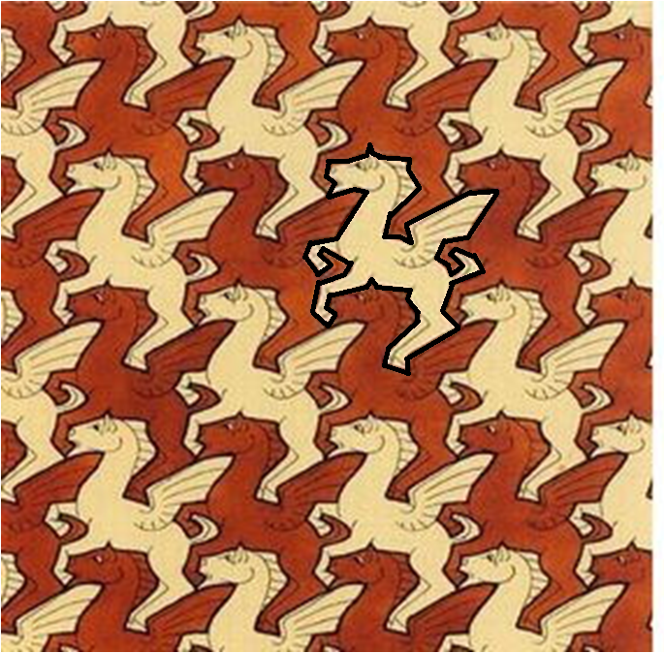
ANSWER (4)
NOTE: For answers 1-4, you can actually draw arrows in any direction—the idea is that in a translation tessellation (which can go on infinitely in a plane) the shapes are translated in EVERY direction (i.e. infinite directions)
Notes:
Sources:
[Slide 1] “Bird Translation Tessellation.” Wikihow.com. https://www.pinterest.com/pin/171840542003912257/
[Slide 2] “Translation.” Mathisfun.com. https://www.mathsisfun.com/geometry/translation.html.
[Slide 3] “Tessellations.” MathEngaged.org. http://mathengaged.org/resources/activities/art-projects/tessellations/.
[Slide 4] “Translation Tessellations.” Arts and Craft. 3rd ESO. http://artsandcrafts3eso.weebly.com/tessellation.html
[Slide 8] “Translation Tessellation.” Interactivate.com. http://shodor.org/interactivate/discussions/SymmetryInTessellati/
[Slide 10] “Bird Translation Tessellation.” https://www.pinterest.com/pin/410390584778362590/.
[Slide 12] “Flying Horses.” M.C. Escher. 1959.

