Slide 1
TESSELLATIONS: Geometry and Art in Islamic Tile Work

Slide 2
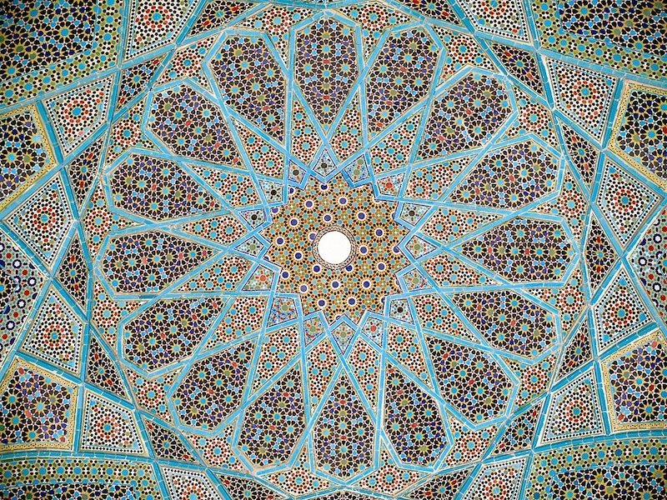
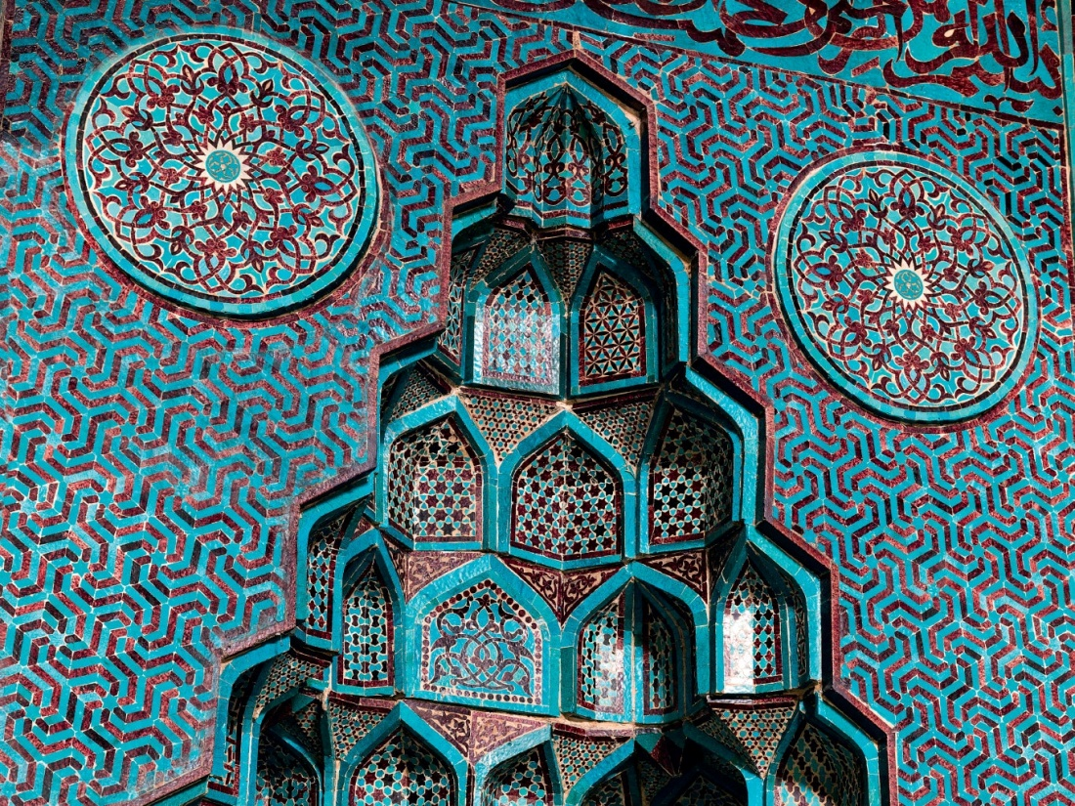
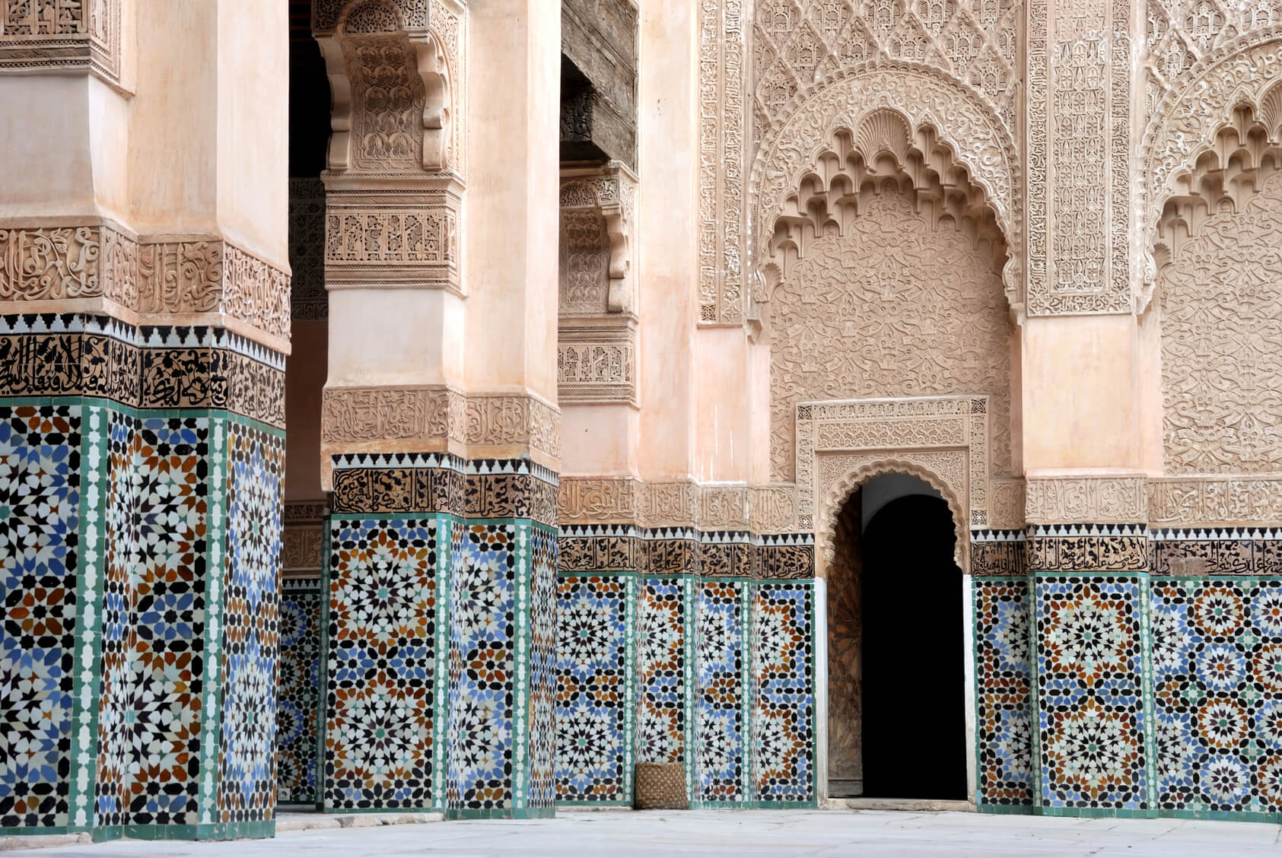
Notes:
Tilework of the Islamic world is, perhaps, the most complex and visually-stunning application of geometric patterning ever undertaken. On the walls of built structures across the vast Islamic Empire—which lasted for nearly 1,300 years, from the early 7th century into the early 20th century—artisans created beautifully-intricate tile mosaics, using mathematical principles not even understood in Western science until the late 20th century! Over the course of this program we engage with this fabulous art by exploring the close connections between art and mathematics in Islamic tessellated tilework.

Slide 3
PART 1: Introduction to Islamic Art

Slide 4
What is Islam?
A religion based on the teachings revealed to Muhammad (c.571-632 CE) by God in the early 7th century CE. These teachings are codified into the text known as the Qur’an (also: Koran).
What is Islamic art?
Not just art made for a religious purpose (ex: a mosque), but all art and architecture produced in the lands ruled by the Muslims, for Muslim patrons, or by Muslim artists—from the 7th century until today.
Notes:
To begin: What exactly is Islam, and how are we defining Islamic art? Briefly, Islam is a way of life, legal system, and religious code based on the teachings revealed to Muhammad by God in the early 7th century. These teachings were recorded by Muhammad and compiled into the text known as the Qur’an. The Qur’an is the central religious text of Islam—like the Bible is for Christianity. According to Islamic belief, Muhammad was a prophet of God just as Abraham, Moses, and Jesus were prophets of God.(1)
Islam is a monotheistic religion, meaning that followers of Islam—called Muslims—believe that there is only one god who created the world. Indeed, the word “Islam” is Arabic for “submission,” meaning that Muslims should live in “submission” to the will of God, who is called “Allah.” Comparatively, Judaism and Christianity are also monotheistic religions, though the precise teachings of each of these religions differ.
When we use the term “Islamic art” we are not just talking about art that was created specifically in the service of the Muslim faith. A prime example of Islamic religious art would be the building and ornamentation of a mosque, which is a Muslim place of worship—like a church is for Christians, or a synagogue is for Jews. Islamic art not only includes religious art, but also more broadly the art and architecture that was “produced in the lands ruled by the Muslims, for Muslim patrons, or created by Muslim artists” from the 7th century until the current day.(2) As we will see shortly when we look at the territorial extent of the Islamic Empire, at certain points in history this has encompassed art from a huge stretch of land across the Middle East, Asia, North Africa, and even Southern Spain.
Paragraph adapted from the Metropolitan Museum of Art handout “Islamic Art and Geometric Design: Activities for Learning,” pg. 10. https://www.metmuseum.org/-/media/files/learn/for-educators/publications-for-educators/islamic_art_and_geometric_design.pdf.
(2) Metropolitan Museum of Art “The Nature of Islamic Art” by the Department of Islamic Art, 2001. https://www.metmuseum.org/toah/hd/orna/hd_orna.htm.

Slide 5
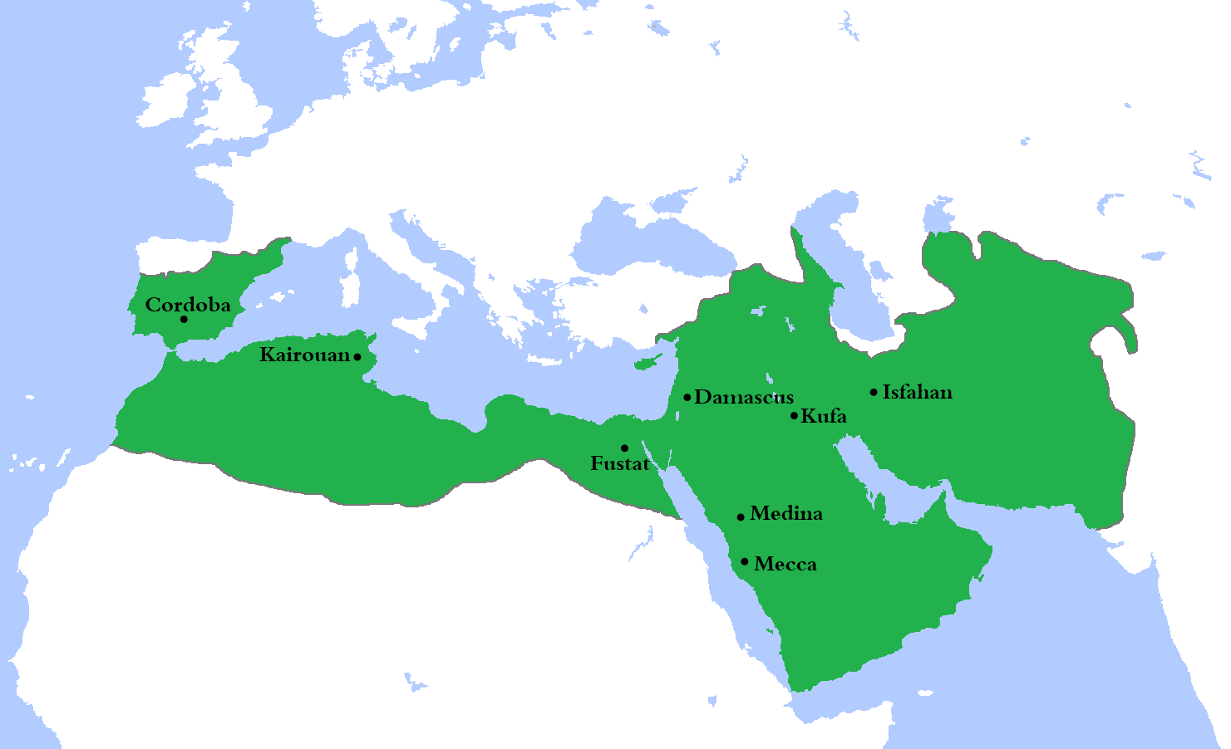
Islamic Empire in 750 CE
Notes:
In this map we can see the lands ruled by the Islamic Empire at the height of its territorial expanse, around the middle of the 8th century. It includes the area of modern-day Uzbekistan, Turkmenistan, Afghanistan, Pakistan, and Iran to the far left, Iraq, Syria, Saudi Arabia, Yemen, and parts of Turkey on the Arabian Peninsula, parts of Egypt, Libya, Tunisia, Algeria and Morocco in Northern Africa, and even some of Spain and Portugal on the Iberian Peninsula to the right. However, many of these lands already had their own artistic traditions before they were conquered by the Islamic Empire in the 8th century. Therefore, it was often the case that “Islamic” art adopted some preexisting traditions and knowledge from local environments as the religion and culture spread.(3)
When we talk about the Islamic Empire, not only are we talking about an enormous swath of lands and peoples, but a huge span of time as well. Beginning in the early 7th century, the last Islamic Empire—the Ottoman Empire—was only dissolved after the end of World War I, in 1922. Even though the Islamic Empire no longer exists today, we still include contemporary art and architecture produced in lands previously ruled by the Islamic Empire or by people from those lands, for Muslim patrons, or by Muslim artists generally under the category of “Islamic art.” So this is quite a number of objects!
(3) Metropolitan Museum of Art “The Nature of Islamic Art” by the Department of Islamic Art, 2001. https://www.metmuseum.org/toah/hd/orna/hd_orna.htm.

Slide 6
PART 2: Geometric Patterns in Islamic Art
Notes:
As we have discussed, the Islamic Empire had a huge geographic spread and a long history. Even so—indeed, remarkably so—“Islamic Art” for the most part remains recognizable and unifying.(4) One of the key characteristics of Islamic Art, especially Islamic art produced between the 8th and the 15th century, is the extensive use of geometric patterning.
(4) Metropolitan Museum of Art “The Nature of Islamic Art” by the Department of Islamic Art, 2001. https://www.metmuseum.org/toah/hd/orna/hd_orna.htm.

Slide 7
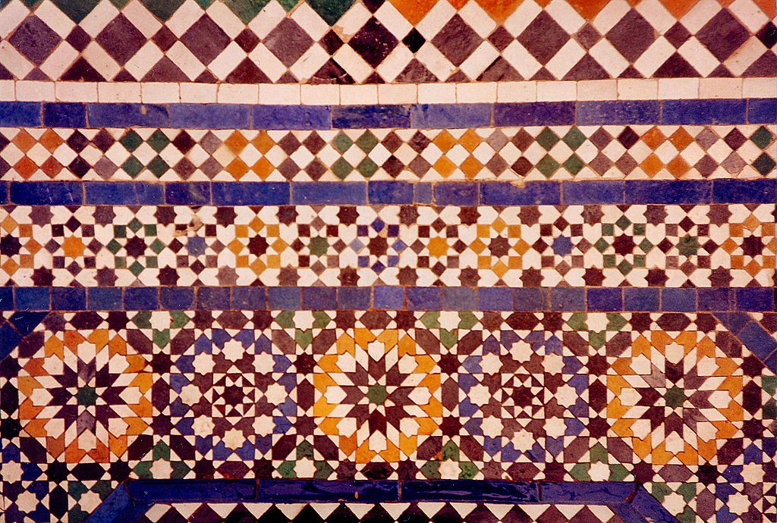
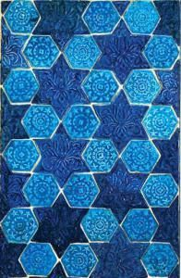
Use four basic shapes to form more complicated patterns:
1) circles; 2) squares; 3) stars; 4) multisided polygons
Polygon: 2D figure with at least three straight sides and angles
PRACTICE: What shapes can you identify in each of the tile patterns below?
Notes:
Four basic shapes are used in Islamic art to form more complicated patterns: circles, squares, stars, and multisided polygons.(5) A polygon is a two-dimensional figure with at least three straight sides and angles, and therefore includes a number of shapes: from triangles to hexagons, among others.
Take a minute to look at these two tile patterns. The one to the left is a tile pattern from Marrakech in Morocco. The pattern to the left is a 13th or 14th century tile panel from Nishapur, Iran. What shapes can you identify in each of these tile patterns?
Answer: (left) squares, rectangles, triangles, rhombuses, eight-pointed stars, etc.; (right) six-pointed stars (or hexagram), hexagons.
(5) Metropolitan Museum of Art handout “Islamic Art and Geometric Design: Activities for Learning,” pg. 10. https://www.metmuseum.org/-/media/files/learn/for-educators/publications-for-educators/islamic_art_and_geometric_design.pdf.

Slide 8
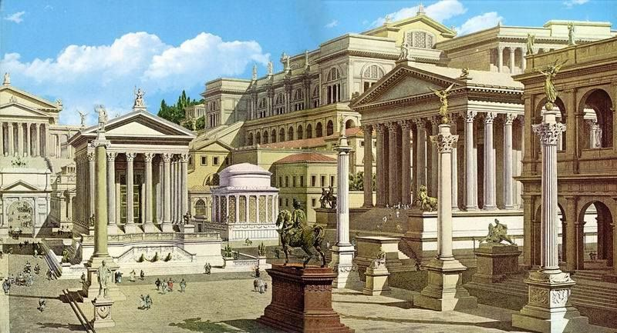
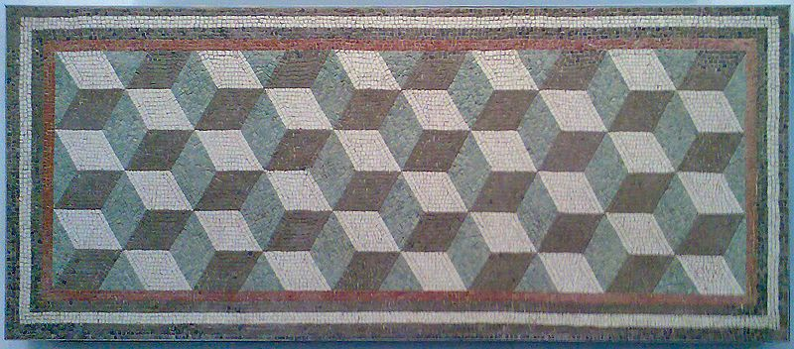
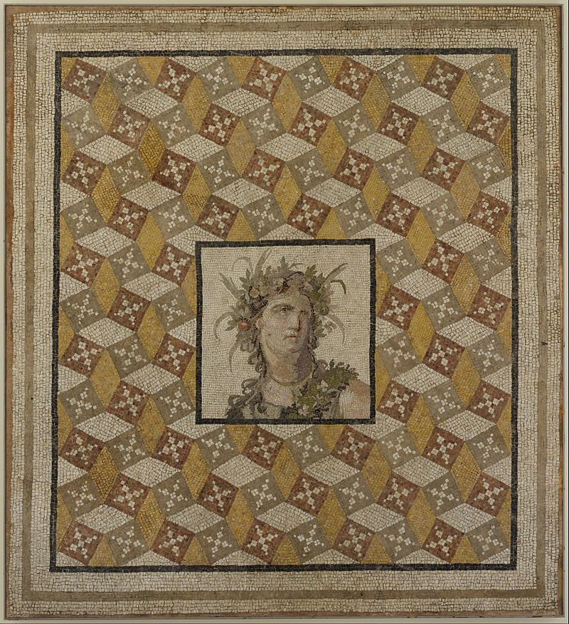
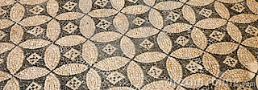
(L) View of the Roman Forum today; (R) Artist’s reconstruction of the Roman Forum, c.600 BCE
(Below) Examples of Roman geometric tile work, 2nd-4th century CE
Notes:
Although geometric patterning reached a pinnacle in the Islamic world, the sources for the shapes and patterns existed in late antiquity, among the Greeks, Romans, and Sasanians from Iran.(6) Here you can see examples of Roman geometric tile patterning dating from between the 2nd to the 4th century. Notice how they have also used circles and polygons in their mosaic patterning, just like the shapes that are used in Islamic art nearly 400 years later.
(6) Metropolitan Museum of Art, “Geometric Patterns in Islamic Art” by the Department of Islamic Art, 2001. https://www.metmuseum.org/toah/hd/geom/hd_geom.htm.

Slide 9
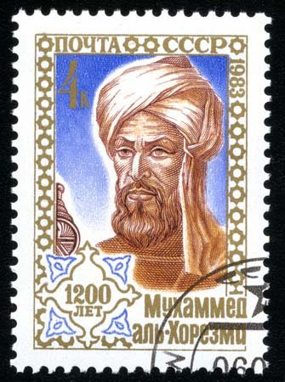
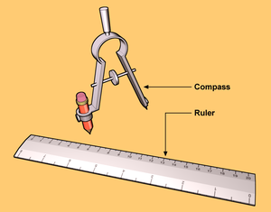
What made complex geometric patterning possible?
Adopted from previous artistic traditions
Mathematical and scientific advances made during the 9th and 10th centuries in the Islamic Empire
Islamic artisans used only a compass and straightedge to create the patterns for their designs—tools we still use in mathematics and art today!
Left: U.S.S.R postage stamp from 1983 showing the important medieval Muslim mathematician Al-Khwārizmī (full name: Muḥammad ibn Mūsā al-Khwārizmī) (c.780-850 CE).
Notes:
What made complex geometric patterning possible in the Islamic world? As we just discussed, these artisans firstly adopted basic shapes and principles from previous artistic traditions—like the Roman Empire. But in Islamic arts they not only appropriated elements of previous artistic traditions, but also greatly elaborated on them to form much more complex geometric designs.(7) This was made possible by the numerous developments in mathematics made by Muslim researchers during the 9th and 10th centuries. One such famous mathematician was Al-Khwārizmī (pictured here in a USSR postage stamp from 1983), who is considered the father of modern algebra. Building on the discovery of new geometric principles, and using only a compass and a ruler, artisans in the Islamic Empire could create patterns so mathematically complex that we are still trying to unravel their secrets.
(7) Metropolitan Museum of Art, “Geometric Patterns in Islamic Art” by the Department of Islamic Art, 2001. https://www.metmuseum.org/toah/hd/geom/hd_geom.htm.

Slide 10
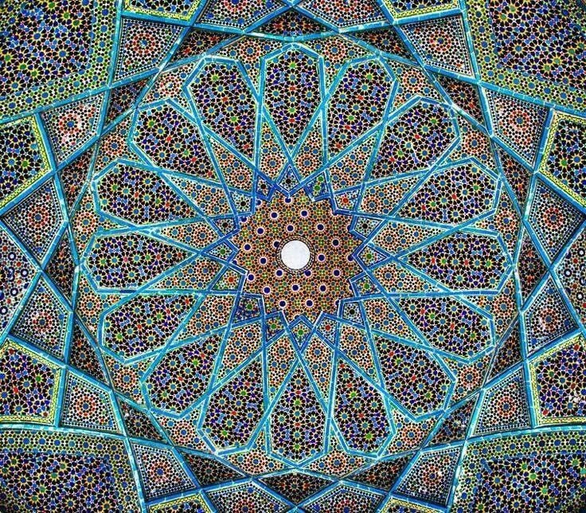
Religious-Cultural Significance
Qur’an prohibition on idolatry (e.g. the worship of cult images)
Importance of unity, logic, and order
Geometric pattern as a means to spiritual contemplation of the infinity and perfection of Allah
Notes:
Geometric patterns also had particular religious-cultural significance in the Islamic world. The Qur’an does not specifically forbid the creation of figural representations (i.e. images of humans or animals). However, early Islamic religious leaders interpreted its stance against idolatry—or, the creation and worship of images—very strictly, and preferred aniconic images.(8) Aniconic images are those that avoid direct representation of natural or supernatural figures. For example, a representation of God as a human figure would be expressly forbidden. Geometric patterns are aniconic because they do not attempt to represent human or animal forms, only repeated and combined shapes.
Muslims believe in the “unity, logic, and order” of the universe as created by Allah.(9) Geometric patterns can represent the idea of a unified and orderly universe without direct representation of any human or animal forms because the repeating patterns form a kind of “unity of shapes.” Similarly, the idea of repeating pattern and certain shapes that are used in Islamic art can symbolize the infinite nature of God. For example, circles have no beginning and no end, and so are a kind of “infinite” shape; a seemingly-unending repetition of geometric designs can give the viewer a concrete idea of the infinite nature of Allah. In this way, geometric patterns can portray the essence of things—of the universe—without depicting their physical form.(10)
(8) Metropolitan Museum of Art handout “Islamic Art and Geometric Design: Activities for Learning,” pg. 10. https://www.metmuseum.org/-/media/files/learn/for-educators/publications-for-educators/islamic_art_and_geometric_design.pdf.
(9) Metropolitan Museum of Art handout “Islamic Art and Geometric Design: Activities for Learning,” pg. 10. https://www.metmuseum.org/-/media/files/learn/for-educators/publications-for-educators/islamic_art_and_geometric_design.pdf.
(10) Paragraph adapted from “Islamic Art” by Zarah Hussain, 2009. https://www.bbc.co.uk/religion/religions/islam/art/art_1.shtml.

Slide 11
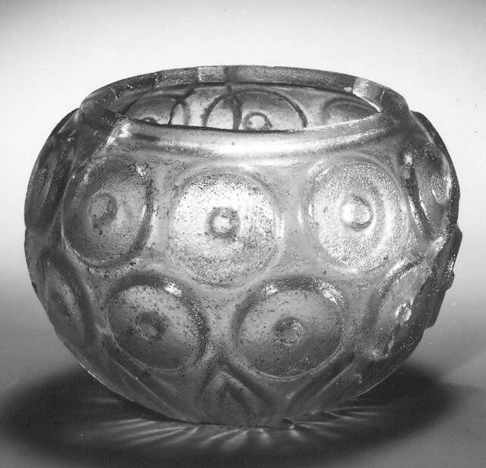
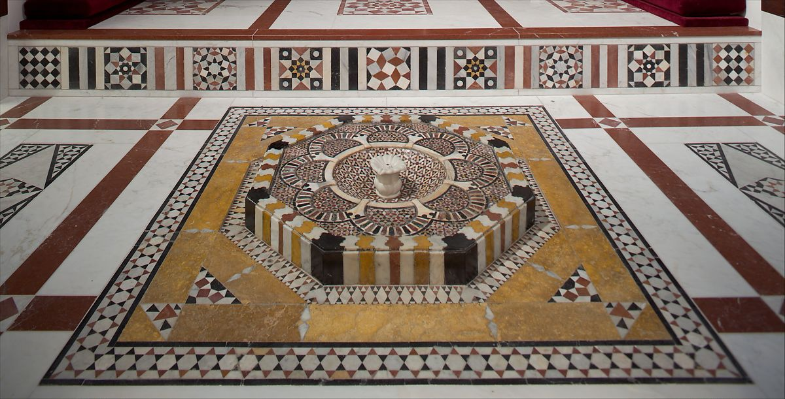
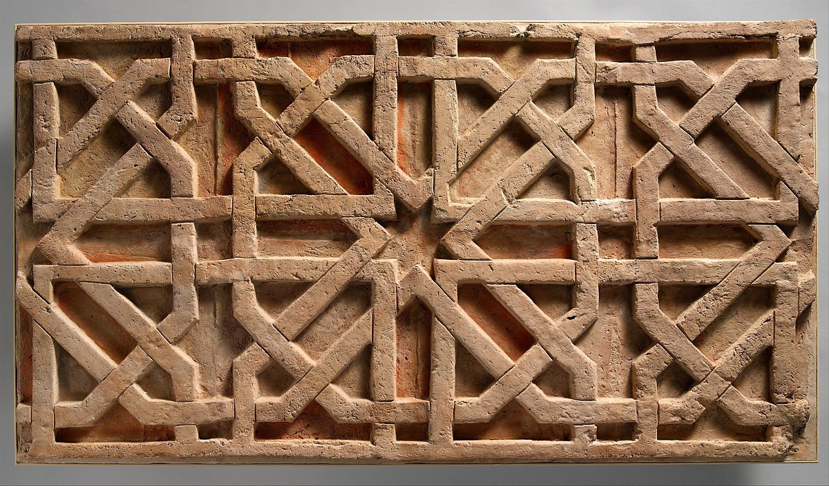
…We can see geometric patterning across the material culture of the Islamic Empire—from bowls and fountains (above), to tiles and textiles (below)!
Notes:
Given their religious-cultural significance, it is not surprising that we see geometric patterning in many items of Islamic material culture: from a 9th-10th-century glass bowl, to an 18th-century fountain, to a 10th-11th-century tile, and a 14th-15th-century textile. However, while many different kinds of geometric patterning on many different kinds of objects were created in the Islamic world, in the final section of this presentation we will zero in on just one category: that is, tessellated tile work of the Islamic Empire.

Slide 12
Part 3: Islamic Tile Tessellations

Slide 13
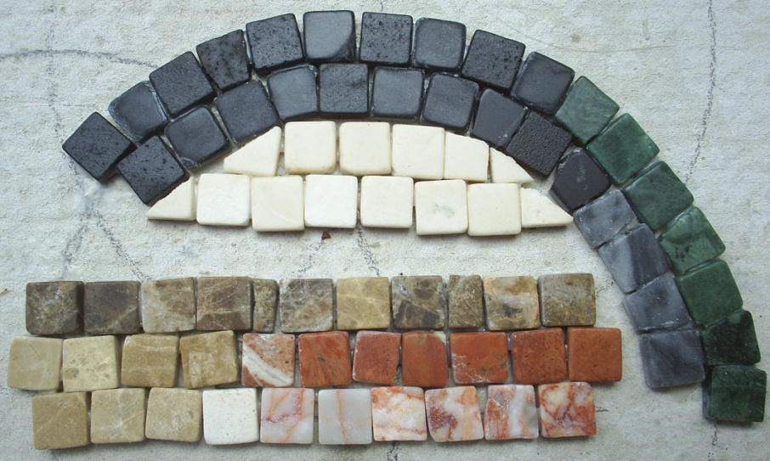
Tessellation
Derives from the Latin term “tessera,” i.e. a small square stone, tile, or piece of glass used in the construction of a mosaic
Tessellation: a repeating pattern of shapes that can continue infinitely on a plane (e.g. a flat surface) where there are 1) no gaps or holes between shapes and 2) no overlaps between shapes. Also called “tiling.”
Notes:
First, what is a tessellation? The term derives from the Latin term “tesserae,” which is a small square stone, tile, or piece of glass that is used in the construction of a mosaic. You can see examples of tesserae in the picture here. A tessellation is a particular kind of pattern, one in which one or more shapes are repeated on a plane (e.g. a flat surface) with no gaps or overlaps between shapes. These patterns can continue infinitely.

Slide 14
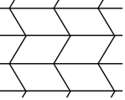
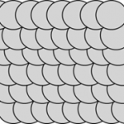
These are tessellations…
These are NOT tessellations…
Notes:
Here we see two examples of tessellations, as well as two examples of patterns that are not tessellations. Thinking back to the definition we just heard, can you see why the two patterns at the bottom of the slide are not tessellations? Answer: they are not tessellations because in the first there are gaps between the repeating circle shapes, while in the second the circles overlap one another.

Slide 15
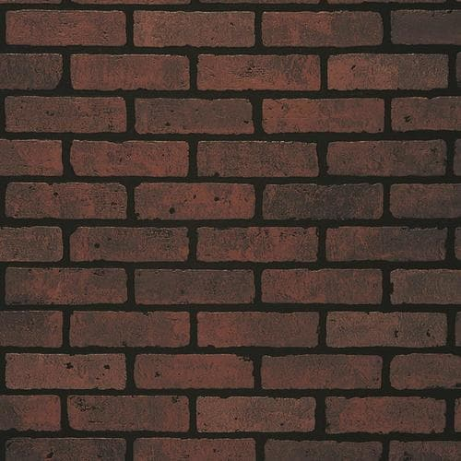
PRACTICE: Look around your house. What tessellations can you find? If possible, take pictures of these tessellation patterns to assemble a “tessellation archive”!
Examples of everyday tessellations…
Brick wall… Wicker Basket … Quilt …
Notes:
You can practice identifying tessellations in your very own home! Look around, and see what tessellating patterns you can identify. Once we know what to look for, we can identify many different tessellations in our everyday lives: for example, a brick wall, a wicker basket, even certain quilts!

Slide 16
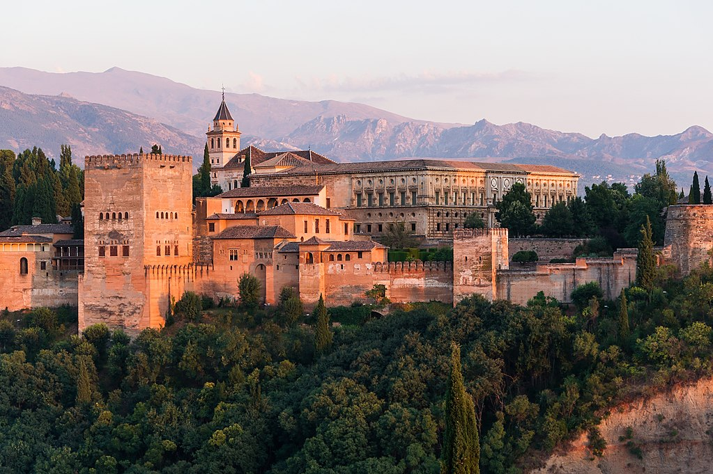
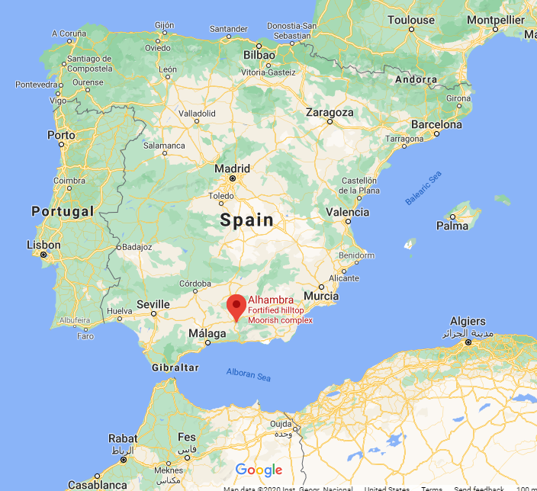
Case Study: Alhambra (Granada, Spain)
Did you know…
The Dutch artist M.C. Escher (1898-1972) visited the Alhambra in the early 20th century. He was so inspired by the tilework he saw that he began to create his own tessellations—artworks that are still famous today!
Alhambra: a Moorish palace constructed mostly between the 13th and 14th centuries. The Alhambra was first used as a fortress.
*Moors: African Muslim peoples who conquered the Iberian peninsula in the 700s CE*
Notes:
Perhaps the most famous case of tessellating tilework ever produced in the Islamic world are those found at the Alhambra in Granada, Spain. This was a Moorish palace constructed between the 13th and 14th centuries, and as we will see it contains many beautiful examples of tessellated tile work. In fact, the palace is so awe-inspiring that the Dutch artist M.C. Escher began creating tessellating patterns in his artwork after he had visited Alhambra in the early 20th century! These artworks are still famous today, and we will see several examples from his work in the following PowerPoints of this series.

Slide 17
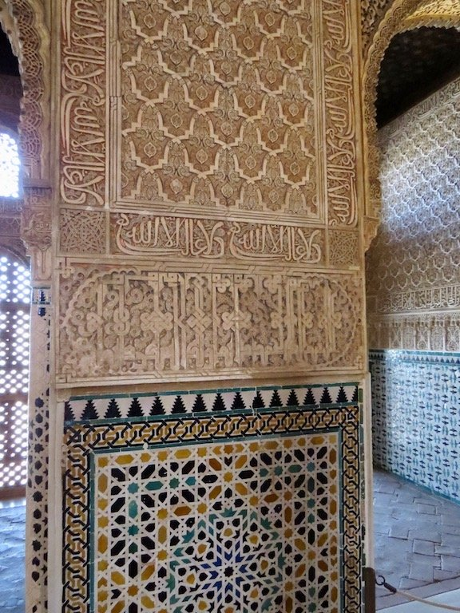
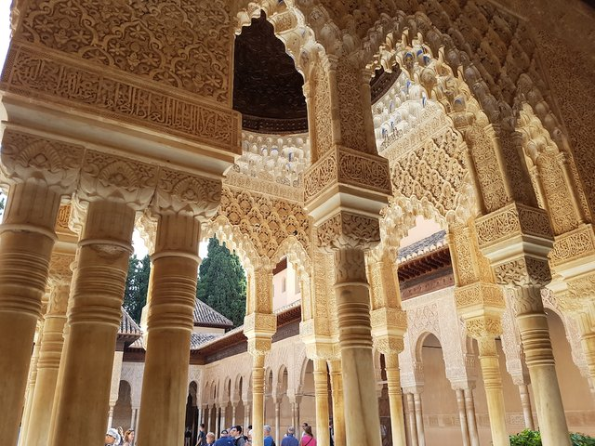
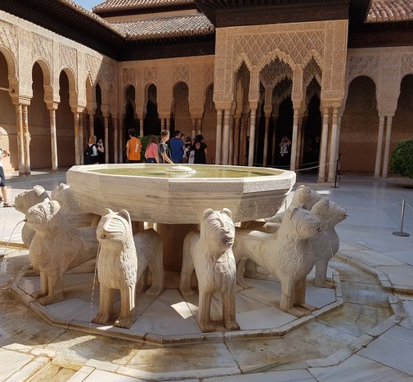
Notes:
Here you can see a few views of the interior of the Alhambra, including some of its amazing tile work to the left. For the rest of this presentation, we’ll see a few more examples of tessellating patterns at Alhambra, and I will briefly explain how shapes are repeated to create them.

Slide 18
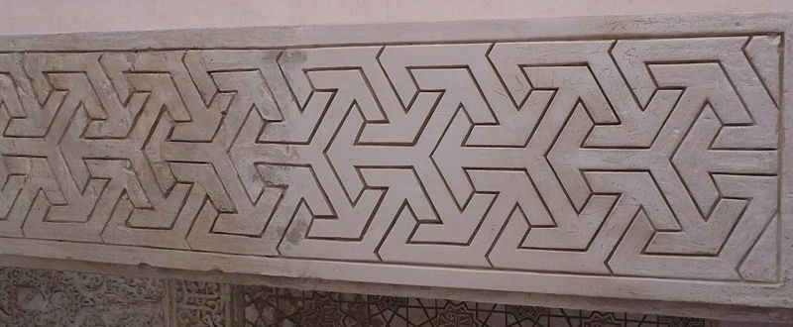
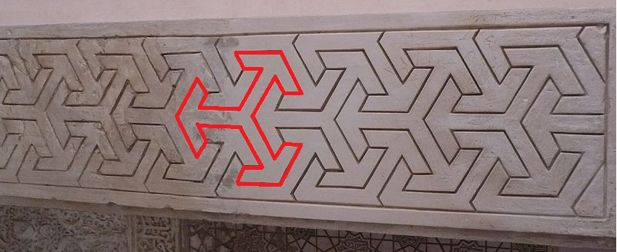
(L) Border pattern at Alhambra
The shape outlined in red is moved in the directions indicated by the arrows in order to make this tessellation
Notes:
First, here is an example of a border pattern at Alhambra. The shape outlined in red is translated (e.g. slid) up, down, and to each side in order to form a pattern of interlocking shapes. Because the shape is slid to repeat it, with no gaps or overlaps between shapes, this is a translation tessellation.

Slide 19
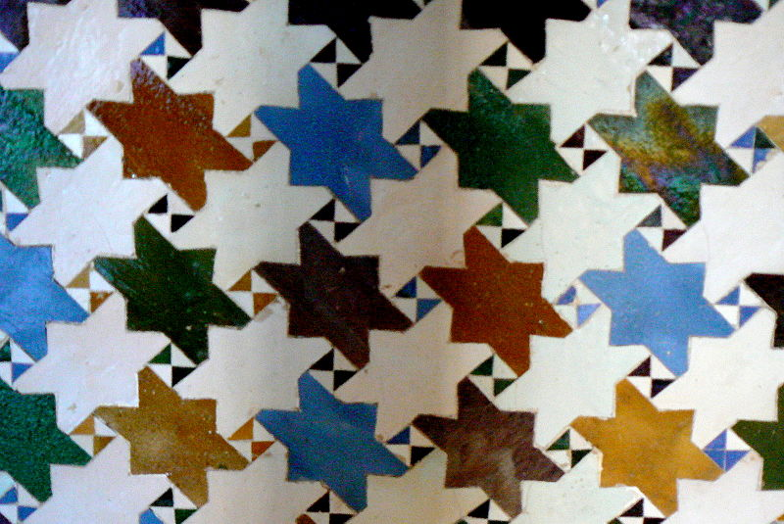
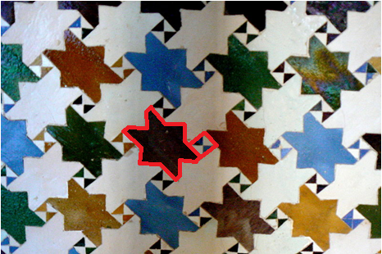
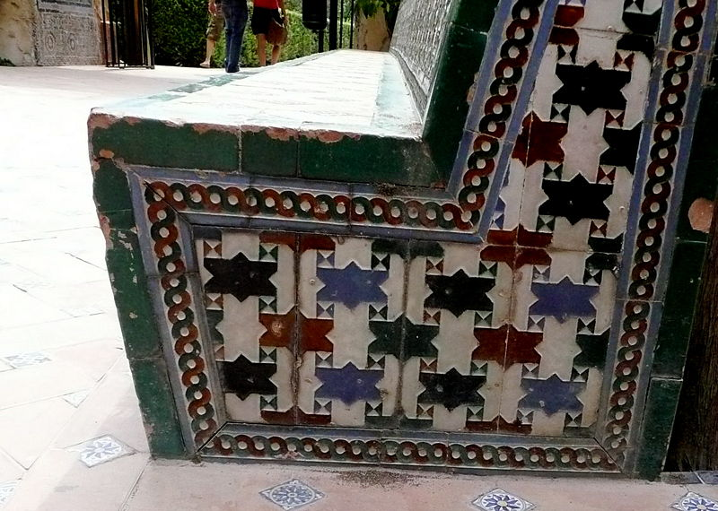
The same tile pattern used on a wall (above) and bench (left) at Alhambra. The tessellation of star-like polygons and squares is simply oriented differently . To form the tessellation, the star-polygon rotated and translated, while the squares are translated.
Translation: to “slide” a shape. *For further explanation, see the “Translation Tessellation” PowerPoint in this series.
Notes:
Now we can see two examples of the same tile pattern from Alhambra, used on a wall (top picture) and a bench (bottom picture). This tessellation of star-like polygons and squares is formed by rotating (i.e. turning) and translating (i.e. sliding) the star-polygon, while the squares are translated. In the next PowerPoint in this series, we will delve more into the mechanics of translation, but for now it is enough to understand that to translate means to “slide” a shape.

Slide 20
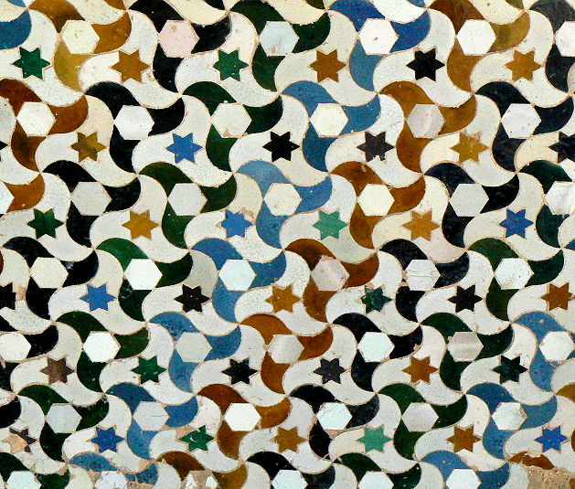
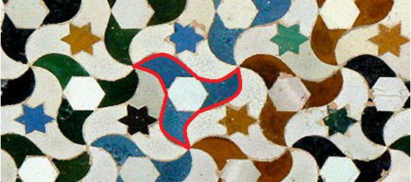
These two walls at Alhambra show the same basic pattern of a 3-armed shape. The tessellation is made by rotating and translating it.
Notes:
Here are two walls at Alhambra that use the same basic tessellating pattern of a three-armed, starfish-like shape. Even though each of these shapes is colored either black or white in the wall on the left, while in the wall on the right they are further broken up into hexagon, star and other shapes in many colors, the basic tessellating shape in each is the same—as you see clearly with the shape outlined in red in the lower right picture. Both of these are tessellations because this shape is rotated and translated to produce the pattern, with no gaps or overlaps between each shape.

Slide 21
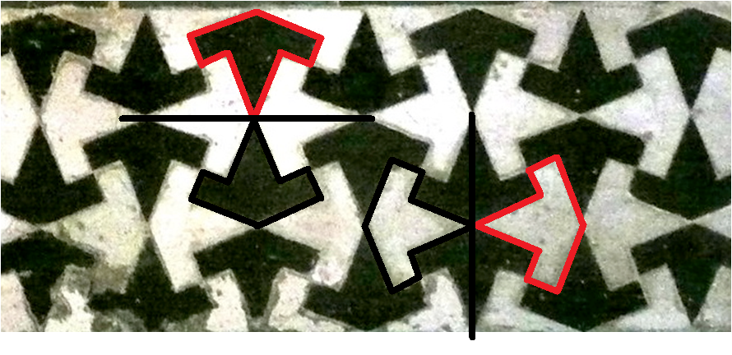
In this tessellated tile border at Alhambra, notice how the shapes outlined in black are reflected over the lines (drawn in black) to produce the shapes outlined in red.
PRACTICE: The shapes in this tessellation are not only reflected, but also translated (i.e. slid). With your finger (if using a screen) or a pen, outline at least one shape that is a translation of each of the shapes outlined in red. Draw an arrow to indicate the direction of the translation.
Notes:
In this tessellated tile border at Alhambra, notice how the shapes outlined in black are reflected (e.g. flipped) over the lines (drawn in black) to produce the shapes outlined in red. This is also a tessellation because a single shape is repeated across the surface, with no gaps or overlaps between each.

Slide 22
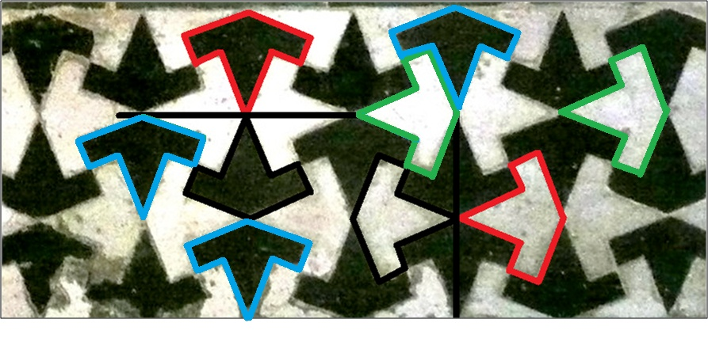
PRACTICE ANSWER:
1
2
The shapes outlined in blue are translations of shape 1, and the blue arrows indicate the direction of translation. The shapes outlined in green are translations of shape 2, and the green arrows indicate the direction of translation. *Note: more translations are possible*

Slide 23
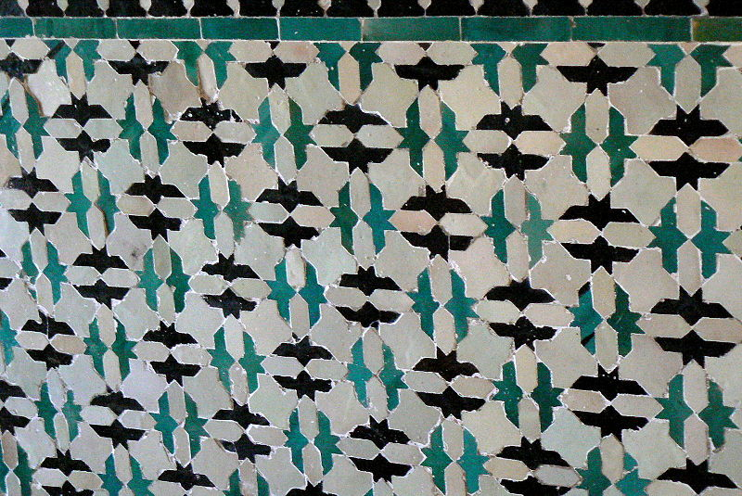
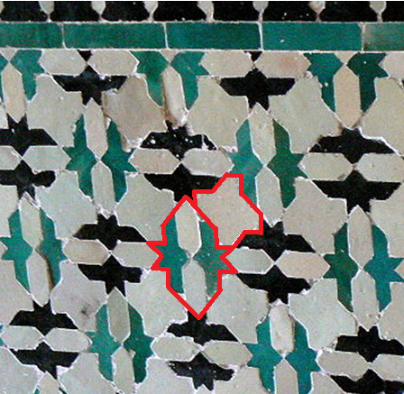
(L) Tiling on a wall at Alhambra
Shape 1 is rotated 90 degrees and repeated in the tessellation, while shape 2 is reflected across a horizontal and a vertical line and repeated in the tessellation.
Reflection: flipping a shape across a line, called a line of reflection. *For more on reflection, see the “Glide Reflection Tessellation” PowerPoint in this series.
2
1
Notes:
As a final example—though there are many more tessellations and other kinds of geometric patterning present at Alhambra—in this beautiful tiling at Alhambra, shape 1 is rotated 90 degrees to produce the shape next to it, while shape 2 is reflected—e.g. “flipped”—across a horizontal and a vertical line to create the tessellation. In the PowerPoint on reflection in this series, we will delve more into the mechanics of reflection, but for now it is enough to understand that to reflect means to “flip” a shape. The pattern resulting from these translations and reflections only uses these two shapes, and contains no overlaps or gaps between them—thus, this is a tessellation.

Slide 24
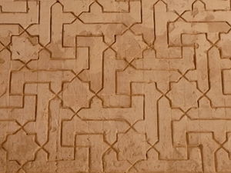
PRACTICE: Find the two different shapes in this tessellation from Alhambra and outline one of each with your finger (if using a screen) or a pen. Are these shapes rotated, translated, reflected --or some combination of one or more of these operations--to produce this pattern?
Notes:
Now you are ready to practice your skills of identifying the shapes that make up a tessellation and identifying how the shapes relate to one another on actual patterns from Alhambra! Find the two different shapes within this tessellation from Alhambra and outline one of each with your finger (if using a screen) or a pen. Are these shapes rotated, translated, reflected—or some combination of one or more of these operations—to produce this pattern?

Slide 25
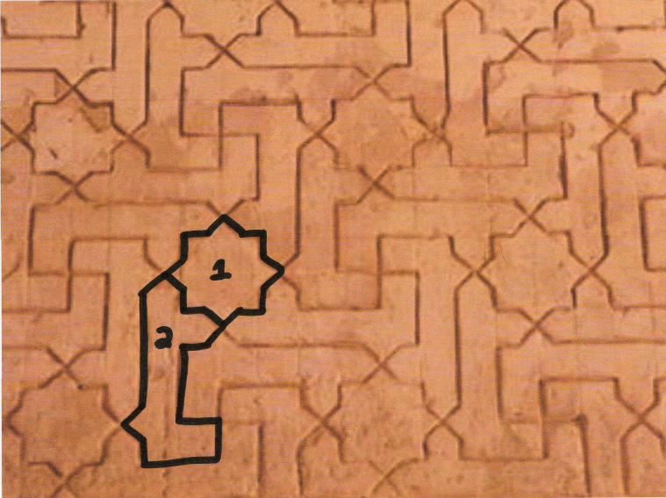
PRACTICE ANSWER:
Shape 1 is translated. Shape 2 is translated, rotated, and reflected (EX: Shape 2 is reflected over a vertical line, then that shape is reflected over a horizontal line to produces 3)
3

Slide 26
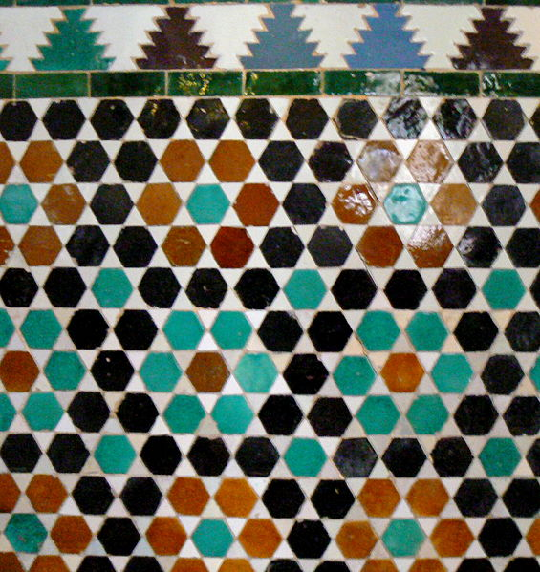
PRACTICE: Find the different shapes in the two tessellations (#1 upper border; #2 lower wall) on this wall at Alhambra. Are these shapes rotated, translated, reflected --or some combination of one or more of these operations--to produce these patterns?
Notes:
Find the different shapes in the two tessellations (#1 upper border; #2 lower wall) on this wall at Alhambra. Are these shapes rotated, translated, reflected—or some combination of one or more of these operations—to produce these patterns?

Slide 27
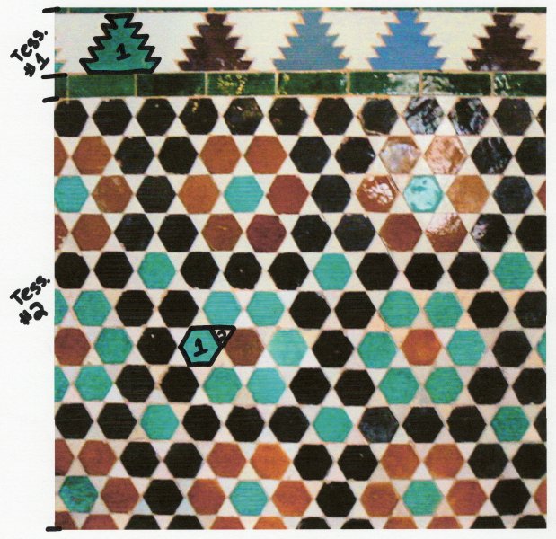
PRACTICE ANSWER:
Tessellation #1: Shape 1 is translated and reflected (EX: Shape 1 reflected over a horizontal line and then translated forms 2)
Tessellation #2: Shape 1 is translated. Shape 2 is translated and reflected (EX: Shape 2 reflected over a horizontal line and then translated forms 3)
2
3

Slide 28
REVIEW OF TERMS
Tessellation: a repeating pattern of shapes that can continue infinitely on a plane (e.g. a flat surface) where there are 1) no gaps or holes between shapes and 2) no overlaps between shapes. Also called “tiling.”
Translation: “sliding”; moving a shape without changing its size, rotating, or flipping it. The shape will look the same, but be in a different place.
Rotation: “turning” a shape around a fixed point.
Reflection: flipping an object across a line—called the line of reflection—without changing its shape or size. The original shape is transformed to a mirror image an equal distance away on the other side of the line.

Slide 29
Sources (1)
Department of Islamic Art. “Geometric Patterns in Islamic Art.” In Heilbrunn Timeline of Art History. New York: The Metropolitan Museum of Art, 2000–. http://www.metmuseum.org/toah/hd/geom/hd_geom.htm (October 2001)
Department of Islamic Art. “The Nature of Islamic Art.” In Heilbrunn Timeline of Art History. New York: The Metropolitan Museum of Art, 2000–. http://www.metmuseum.org/toah/hd/orna/hd_orna.htm (October 2001).
Education. “Islamic Art and Geometric Design: Activities for Learning.” New York: The Metropolitan Museum of Art, 2004. https://www.metmuseum.org/-/media/files/learn/for-educators/publications-for-educators/islamic_art_and_geometric_design.pdf.
Hussain, Zarah. “Islamic Art.” British Broadcasting Company, 2009. https://www.bbc.co.uk/religion/religions/islam/art/art_1.shtml.
[Slide 1] “Enamelled Tiles Mosaic on the Ceiling of the Pavilion in the Tomb of Hafez, Shiraz.” Wikipedia.com. https://en.wikipedia.org/wiki/Tomb_of_Hafez#/media/File:Roof_hafez_tomb.jpg
“Blue Tiled Mihrab in the Eşrefoğlu Mosque in Beyşehir, Turkey.” Architecturaldigest.com. https://www.architecturaldigest.com/gallery/100-most-iconic-islamic-houses-worship.
“Cross-Shaped Tile.” Metropolitan Museum of Art. https://www.metmuseum.org/art/collection/search/450453.
“Ali Ben Youssef Madrassa in Marrakech, Morocco.” Depositphotos.com. https://depositphotos.com/8443908/stock-photo-ali-ben-youssef-madrassa-in.html.
[Slide 5] “Map of the Spread of Umayyad Empire in 750 CE.” Khan Academy. https://www.khanacademy.org/humanities/world-history/medieval-times/spread-of-islam/a/the-rise-of-islamic-empires-and-states.
[Slide 7] “Zellige Terracotta Tiles in Marrakech.” Wikipedia.com. https://en.wikipedia.org/wiki/Tessellation#/media/File:Ceramic_Tile_Tessellations_in_Marrakech.jpg.
“Star- and Hexagonal-Tile Pattern.” Metropolitan Museum of Art. https://www.metmuseum.org/learn/educators/curriculum-resources/art-of-the-islamic-world/unit-three/featured-works-of-art/image-14.
[Slide 8] “Panoramic View of the Roman Forum.” Wikipedia.com. https://en.wikipedia.org/wiki/Roman_Forum#/media/File:Forum_Romain_05_2017.jpg.
“Artist’s Reconstruction of the Roman Forum.” Pinterest.com. https://nl.pinterest.com/pin/350506783480573194/.

Slide 30
Sources (2)
“Mosaic Floor Mosaic with Bust.” Metropolitan Museum of Art. https://www.metmuseum.org/art/collection/search/253565.
“Roman Geometric Mosaic.” Wikipedia.com. https://commons.wikimedia.org/wiki/File:Roman_geometric_mosaic.jpg.
“Roman Mosaic.” Canstockphoto.com. https://www.canstockphoto.com/roman-mosaic-0703296.html.
“1983 USSR Postage Stamp of Al-Khwārizmī.” Brittanica.com. https://www.britannica.com/biography/al-Khwarizmi.
[Slide 11] “Cut Glass Bowl.” Metropolitan Museum of Art. https://www.metmuseum.org/art/collection/search/451805.
“Fountain in Damascus Room.” Metropolitan Museum of Art. https://www.metmuseum.org/art/collection/search/452102.
“Tile Panel.” Metropolitan Museum of Art. https://www.metmuseum.org/art/collection/search/449599
“Textile Fragment.” Metropolitan Museum of Art. https://www.metmuseum.org/art/collection/search/448232
[Slide 13] “Tesserae.” Blog.Stephens.edu. http://blog.stephens.edu/arh101glossary/?glossary=tessera.
[Slide 14] “Tessellations and Non-Tessellations.” Mathengaged.org. http://mathengaged.org/resources/activities/art-projects/tessellations/.
[Slide 16] “Dawn at Alhambra.” Wikipedia.com. https://en.wikipedia.org/wiki/Alhambra#/media/File:Dawn_Charles_V_Palace_Alhambra_Granada_Andalusia_Spain.jpg.
[Slide 17] “Interior of Alhambra.” Steemit.com. https://steemit.com/steemstem/@highonthehog/alhambra-tessellating-patterns-in-islamic-art
[Slide 18-27] “Tessellating Tile Patterns at Alhambra.” Wikipedia.com. https://mathstat.slu.edu/escher/index.php/The_Alhambra_and_The_Alcazar_(Spain).

