Slide 1
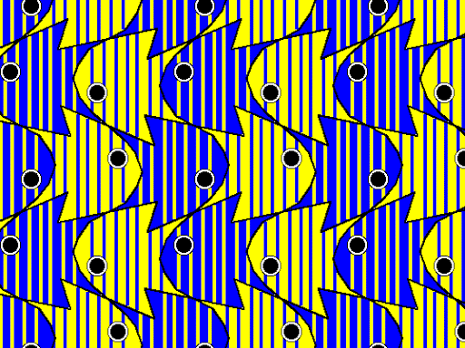
GLIDE REFLECTION TESSELLATION

Slide 2
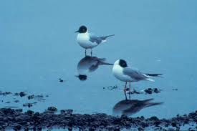
Mathematical Terms
Reflection: flipping an object across a line—called the line of reflection—without changing its shape or size. The original shape is transformed to a mirror image an equal distance away on the other side of the line.
Line of reflection #1
Line of reflection #2
Multiple reflections (R):
Shape A is reflected over line of reflection #1, resulting in shape B
Shape B is reflected
over line of reflection #2, resulting in shape C
B
A
C
Reflection in nature: birds reflected in the water
For a detailed explanation of reflection in mathematical terms, see this Khan Academy lesson: https://www.khanacademy.org/math/geometry/hs-geo-transformations/hs-geo-reflections/v/reflecting-points
Notes:
Before we can understand how a glide reflection tessellation is created, it is important to review a few key mathematical concepts. The first is reflection: this is when an object is flipped across a line—called the line of reflection—without changing its shape or size. By reflecting the object across this line, the original shape is transformed into a mirror image of itself. The reflected shape is also the same distance away from the line of reflection.
We see reflected shapes in our everyday lives. For example, reflections in smooth water. See how the bodies of the birds in the photograph above look as if they have been “flipped” upside down in the surface of the water?
We can also reflect an object multiple times, over several lines. In the diagram to the right, notice how triangle A is flipped across line of reflection 1 to produce shape B. Then, triangle B—that is, the center green triangle—is flipped across a second line of reflection, resulting in shape C.

Slide 3
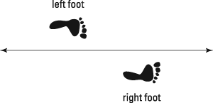
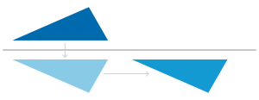
Mathematical Terms
Glide reflection: “flip” and “slide”; the reflection of a shape over a line and then translation* of the shape along that line (e.g. the final shape will be parallel to the line of reflection)
EX: Glide reflection of a shape
Shape is reflected (“flipped”) over a line
Shape is translated (“slid”) parallel to the line
Glide reflection in nature: footprints
1)
2)
*For an explanation of translation, see the “Translation Tessellation” PowerPoint in this series*
Notes:
A glide reflection is a two-fold operation: a “flip” and then a “slide.” The first step is a reflection: as just discussed, the shape is flipped across a line of reflection. The second step is a translation: the shape is “slid” parallel to the line of reflection. In the diagram to the right, you can see the glide reflection broken down into these two steps. However, it actually does not matter which operation—the reflection or the translation—is performed first: translating the shape and then reflecting it will produce the same result, as long as the distance “slid” and the line of reflection are the same.
Again, we can see examples of glide reflections in nature. Have you ever seen the footprints made by someone walking in the sand? These are a great example! In the photo and diagram here, notice how the left footprint is mirrored by the right: Both big toes and heels rest along the line of reflection. If someone were standing still, with their feet aligned and pointing forward, each footprint would be a reflection of the other. The “glide” of the glide reflection comes from the walking action: each footprint is thus “slid” forward from the previous one.

Slide 4
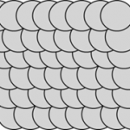
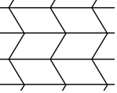
Mathematical Terms
Tessellation: a repeating pattern of shapes that can continue infinitely on a plane (e.g. a flat surface) where there are 1) no gaps or holes between shapes and 2) no overlaps between shapes. Also called “tiling.”
REVIEW: Which of the following are tessellations? Why or why not?
a)
b)
c)
d)
Notes:
Finally, we should briefly review the term “tessellation.” A tessellation is a repeating pattern of shapes that can continue infinitely on a plane—a flat surface. This pattern must first have no gaps or holes between shapes, and second have no overlaps between shapes.
Which of the following four patterns meet are tessellations?
Answer: B and C are tessellations, A and D are not—A because there are gaps between the circles, and D because the shapes overlap.

Slide 5
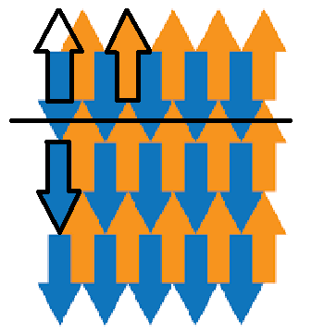
Mathematical Terms
Glide reflection tessellation: a pattern with no gaps or overlaps, made by flipping and sliding a shape to repeat it.
Step 2
Glide reflection tessellation:
Step 1: reflect (“flip”) shape A across the line of reflection, resulting in shape B.
Step 2: translate (“slide”) shape B along the line of reflection (e.g. parallel to it), resulting in the final shape C.
Step 1
B
C
A
Notes:
Having reviewed the terms reflection, glide reflection, and tessellation, we can now understand how glide reflection tessellations are made! Firstly, a glide reflection tessellation is a pattern with no gaps or overlaps (e.g. a tessellation), made by flipping (e.g. reflecting) and sliding (e.g. translating) a shape to repeat it. Similar to the glide reflection diagram we saw on a previous slide, here you can see how the arrow “A” is flipped across a line of reflection and moved parallel to it in order to produce the arrow “C.”

Slide 6
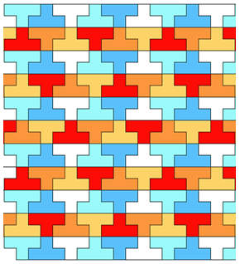
REVIEW ACTIVITY #1:
With your finger—if using a screen—or with a pen, trace all lines of reflection within the pattern on the next slide
EX:
Notes:
In this activity we will practice identifying lines of reflection in tessellations! With your finger—if using a screen—or with a pen, trace all lines of reflection within the pattern on the next slide. As an example, all the lines of reflection in the tessellation on this slide have already been traced.

Slide 7
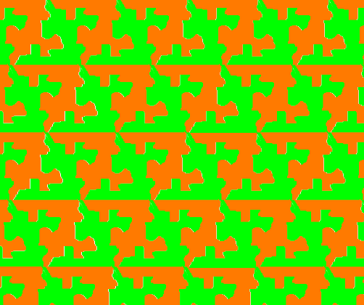

Slide 8
ANSWER

Slide 9
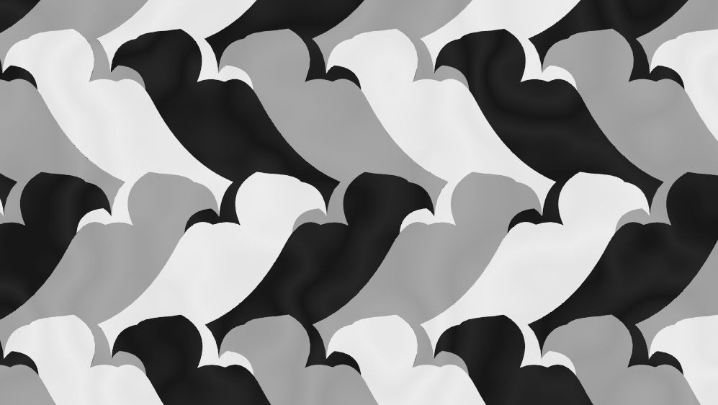
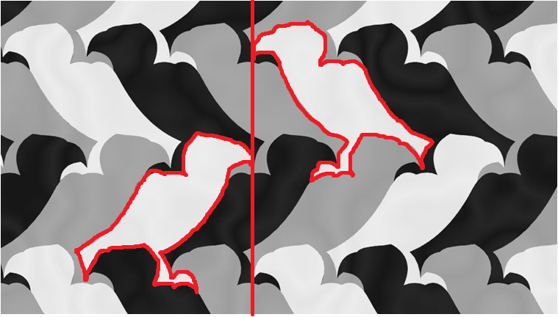
REVIEW ACTIVITY #2:
Regular Tiling no. 17, M.C. Escher
With your finger—if using a screen—or with a pen, trace one shape of the tessellation on the following slide. Then trace a second shape that is a reflection of the first. Draw the line of reflection between the two. Finally, indicate with arrows the reflection of the shape (curved arrow) and the direction of the translation “slide”.
EX:
Notes:
In this activity we will practice identifying glide reflections within tessellations. With your finger—if using a screen—or with a pen, trace one shape of the tessellation on the following slide. Then trace a second shape that is a reflection of the first. Draw the line of reflection between the two. Finally, indicate with arrows the reflection of the shape (curved arrow) and the direction of the translation “slide.” As an example, a shape and its reflection have been outlined in the tessellation on this slide, and the line of reflection and direction of translation have also been drawn in.

Slide 10
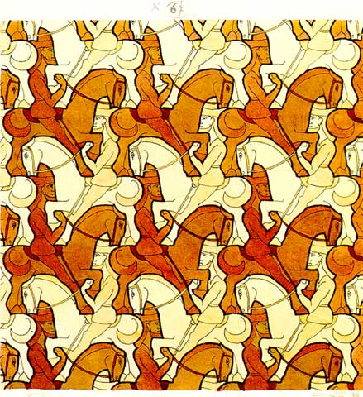
Horsemen, M.C. Escher, 1946

Slide 11
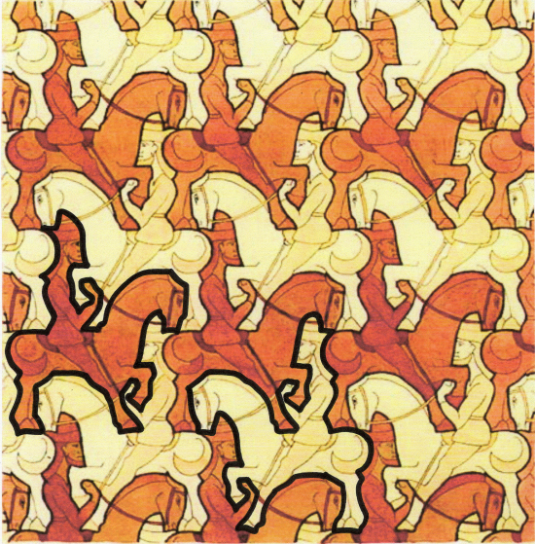
ANSWER
Notes:
Sources:
[Slide 1] “Tropical Fish.” Arcadia’s Art Exhibit. http://cornflower.tripod.com/exhibit.html.
[Slide 2] “Reflections in Math: Definition and Overview.” Study.com. https://study.com/academy/lesson/reflections-in-math-definition-lesson-quiz.html
[Slide 3] “Glide Reflection.” Wikipedia.com. https://en.wikipedia.org/wiki/Glide_reflection
[Slide 3] “How Glide Reflections Work.” Dummies.com. https://www.dummies.com/education/math/geometry/glide-reflections-work/.
[Slide 4] “Tessellations.” MathEngaged.org. http://mathengaged.org/resources/activities/art-projects/tessellations/.
[Slide 5] “Arrow Tessellation.” in “M.C. Escher and Tessellations” (University of Waterloo: Centre for Education in Mathematics and Computing: 2015) https://www.cemc.uwaterloo.ca/events/mathcircles/2015-16/Fall/Junior78_Nov34-Solns.pdf.
[Slide 7] “Reflection Tessellation.” Melinda Kolk. 2020. Web.tech4learning.com. https://web.tech4learning.com/create-reflection-tessellations-in-wixie.
[Slide 9] “Regular Tiling No. 17.” M.C. Escher.
[Slide 10] “Horsemen.” M.C. Escher. 1946.

