Slide 1
Dancing Outdoors
Improvisational movements inspired by natural surroundings
Presentation by Megan Kendzior
University of California at Riverside
Gluck Dance Classroom Fellow

Slide 2
There is a beautiful power inside each and every one of us to dance inspired by the world that we live in, and to create movements based on feelings, images, stories and experiences that are unique to us. Let’s have fun, move our bodies, and use our senses to pay attention to the natural world around us!

Slide 3
Here’s what to do:
Read through this whole document first.
Then, watch the warm up video wherever you have access to the internet and move along with me to get your body ready for dancing.
Then, head outside with either a prompt from this document printed or a portable electronic device with the prompt pulled up.
The warm up video is available on the Gluck Creative Classroom website next to where you found this document.
What you’ll need to have ready:
Your dancing body
Shoes that you can dance in
Pen or pencil and paper

Slide 4
Safety First!
Please take care of yourself when you’re dancing. Listen deeply to your body as you’re dancing. Pay attention to how you’re feeling and move in ways that feel good!
Wear a mask when dancing in public spaces. Wash your hands well when you return to your home.

Slide 5
Keywords for this Class:
Dance
Improvisation
Choreography
Sensorial Awareness
Interpretation
Nature
Outdoors
Connection
Creative Movement
Reflection

Slide 6
Dancing in nature can inspire you to move in new ways. You may be able to feel a connection between yourself and your surroundings.
Photo by Megan Kendzior

Slide 7
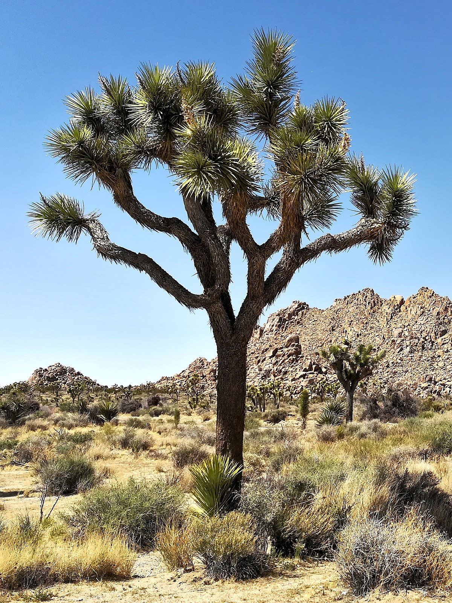
Improvisational Dancing in Nature
Through these materials, you will learn about choreography and dance, and you will develop awareness through improvisational dance exercises outdoors.
The goal is for you to experience your innate and unique power while also finding a connection with the natural surroundings near your classroom or home.
This Photo by Unknown Author is licensed under CC BY-SA

Slide 8
We’ve all been inside for too long.
Let’s go outside, get some exercise, and connect with nature where we live.

Slide 9
Let’s Warm Up!
Taking care of your body is very important as a dancer!
On the Gluck Creative Classroom website, you’ll find a video called Warm Up for Dancing Outdoors.
In this video, you’ll stretch your head, neck, sides, arms, and legs. We’ll also imagine ourselves dancing with the wind, the trees, the plants, and the flowers.
After you’ve finished reading through this package, head on over to the website and dance along with the warm up video before you head outside.
Photo of Megan Kendzior by Jason Goodfriend

Slide 10
Activating Sensorial Awareness: When you get outside, take a deep breath and look around.
When dancing outdoors, you’ll start by scanning the environment around you. Tune into a deeper awareness of what’s around you and notice if there are trees or rocks or bushes or grass or flowers or birds that catch your attention. Trust your impulses as you tune into your natural surroundings.
Photo of Megan Kendzior by Jason Goodfriend

Slide 11
What is nearby? Are there plants, trees, bushes, rocks, animals, water, wind, light, clouds?
What do you see?
Let your breathing slow down and become fascinated with the littlest of things.
Once you are calm and centered, let your mind wander.
Take it all in as if you’re seeing through new eyes.
Photo of Megan Kendzior by Jason Goodfriend

Slide 12
Pick a natural element to focus on!
Move close to the natural being or object that you picked. Spend 3-5 minutes in silence next to it, just looking at it.
Move around it slowly, find a place to sit near or stand looking over it. Notice all of the nuances of the thing you’ve chosen.
Photo of Megan Kendzior by Jason Goodfriend
Use your senses – Is anything moving? What sounds and colors are present? Notice the saturation of the colors. What shapes are present in the object? Is there a smell? What memories or ideas does this object bring up?

Slide 13
Write or draw about what you experienced.
Reflect on what you see. Try to let the words or drawings flow out of you without judgement.
Over the course of 3-5 minutes, notate how you felt during the observation period.
What thoughts came up? What can you remember feeling? Jot it all down or draw a picture of your feelings.

Slide 14
Time
to
Dance!
Photo of Megan Kendzior by Jason Goodfriend
Put your paper aside and begin to move. Dance for 3-5 minutes. Allow the shape, size, color, feeling, and motion of the object to effect how you move. Try moving big, moving small, close to the ground, far away from the object.
Create a dance that reflects that object you chose.

Slide 15
So how did it go? Take a few minutes to reflect on what you learned in this experience of dancing outside. Remember the keywords at the beginning of this lesson and think about what you learned about dance, improvisation and choreography. How did you use your senses to interpret the natural environment around you through creative movement? Share your thoughts with a loved one or classmate.

Slide 16
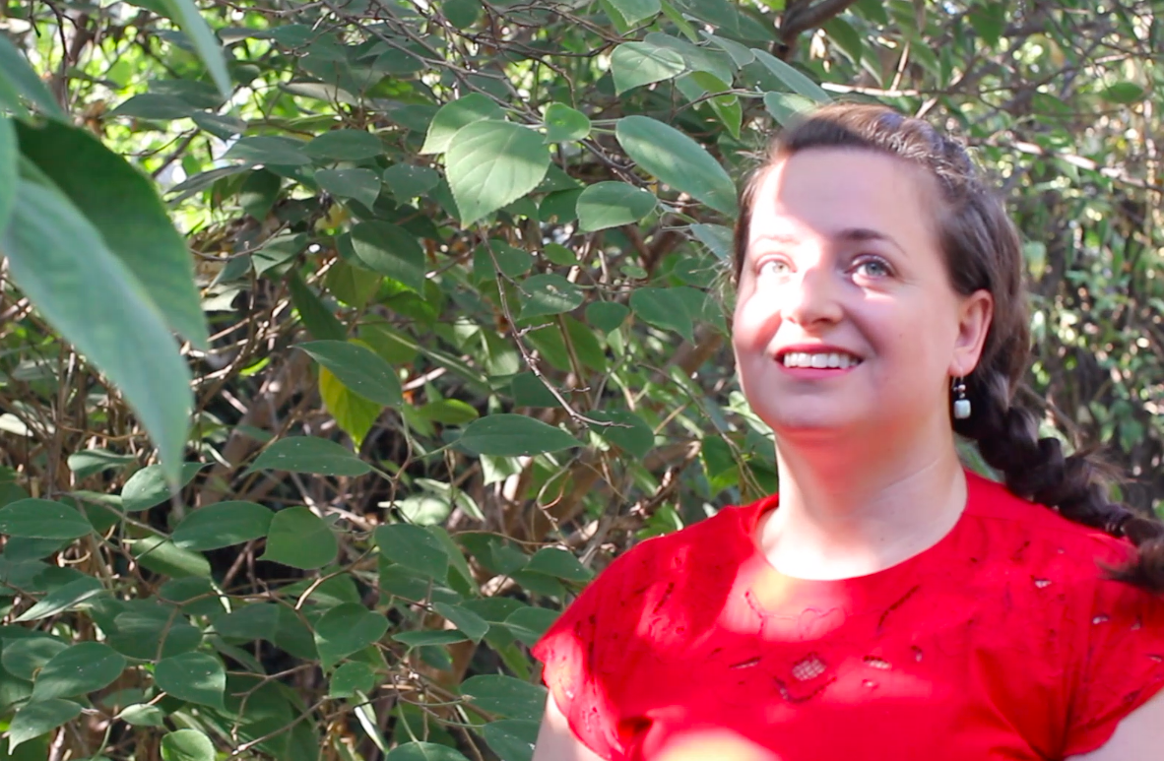
I hope you had fun dancing outside and finding inspiration in your natural surroundings! Now you can take these dance skills and use them whenever you want. Stay safe and enjoy getting outside!
Thank you for dancing with me!
Photo of Megan Kendzior by Jason Goodfriend

