Slide 1
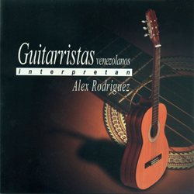
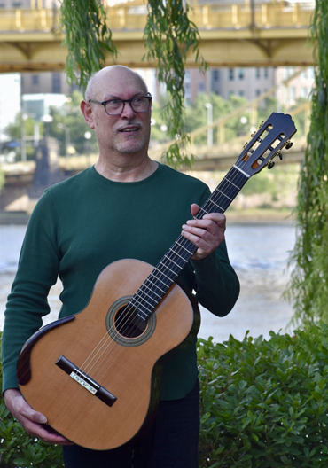
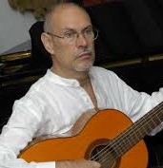
Alex Rodríguez: His Music and Life

Slide 2
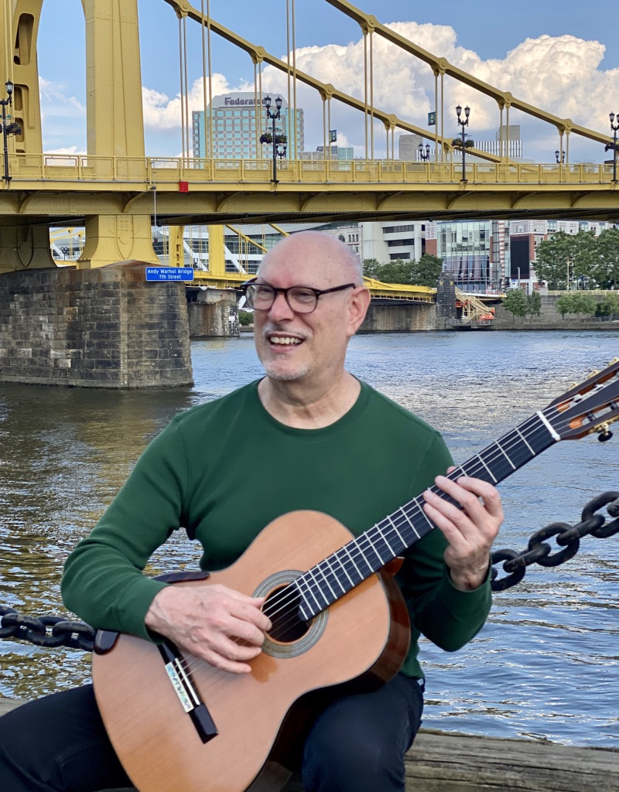
Alex Rodríguez was born in 1952 in Caracas/Venezuela. Since his childhood, Alex felt attracted to the sounds of diverse styles of music. Surrounded by an ambiance where music has always been a significant cultural expression, he decided for the guitar. Although he studied classical guitar in Caracas with the eminent pedagogue Manuel Enrique Pérez Díaz, Alex's musical world was always very diverse and similarly embraced rock and jazz.
Eager to become familiar with other cultures, music represented for Alex an “excuse” to explore the world, and he decided to go to Spain to continue his music studies, where he studied with Regino Sainz de la Maza. There, he remained for some years performing, learning, and enjoying the sojourn, before returning to his country. Once in Venezuela, Alex became an active working musician for diverse bands, radio, and television such as Aldemaro Romero and his Onda Nueva, Renny Show’s Orchestra and Radio Caracas TV’s Orchestra. Alex wrote about his work Mucurafí:
Alex Rodríguez:
His Music and Life
It is inspired by the Andean landscape of one of the southern towns in Mérida's city. This Venezuelan waltz evokes its most traditional origins with an emphasis on melody, adorned with a subtle harmony.
Mucurafí (2:42)

Slide 3
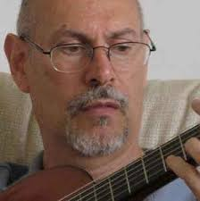
The wish to explore new latitudes, however, aimed him to move for some years to the United States. In New York City, Alex was involved with the jazz scene, especially with Latin jazz orchestras luminaries Mario Bauza and Ray Mantilla, among others, displaying multifaceted roles as composer, orchestrator, guitarist, bassist, arranger, record producer, director, and teacher. In this city, he recorded his album “Busqueda” (1978) with local renowned jazz musicians.
Once back in Venezuela in the 1980s, Alex continued his multilayered musical career, founding the “Symphonic Jazz Season” with the Venezuela Symphony Orchestra and producing his CD “Universe” (2000), together with different musical activities. During this period, Alex felt the call to embrace again the guitar, his main instrument, and compose music for it. Since then, Alex has created a wonderful group of works including solo and chamber music pieces which were recorded for his CD “Venezuelan guitarists play Alex Rodríguez;” the guitar concertos Time Traveler (2001) premiered by the Municipal Symphony Orchestra of Caracas and Katana (2011) premiered by Venezuela Symphony Orchestra, both with Rubén Riera as a soloist. Some of his compositions have won the composition awards, including the Metropolitan District of Caracas Prize of Music. Alex wrote about his work Capaz:
Alex Rodríguez:
His Music and Life
It is a Venezuelan waltz-song musical genre, whose title is based on a town in the Andes. The work embraces a romantic style in which the harmony intertwined with the melody, creates timbral subtleties that describe the landscape.
Capaz (4:48)

Slide 4
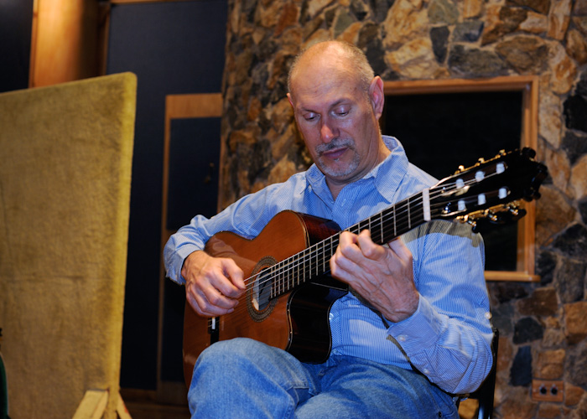
The eminent guitar pedagogue and performer Leopolo Igarza expressed about Alex’s guitar music, “His understanding of the composition and deep knowledge of the guitar, making it one of our finest composers for guitar and orchestra.”
The political crisis in Venezuela forced Alex to embark on another sojourn abroad and move in 2013 to Pittsburg. The United States welcomed Alex with new opportunities for his music. His works Big Band titled Allegheny River (2013) for Big Band; his string quartet Mirrors (2015) is performed by the Sound Impact Quintet during its tour in Costa Rica; his work for solo guitar and chamber orchestra Continental Suite (2018) was premiered in New York City by the North/South Chamber Orchestra conducted by Max Lifchitz, and Hermann Hudde as a soloist. Recently, Alex released his solo guitar album “Tan lejos y tan cerca” (2020) performing his compositions. This album is an immense document for those who appreciate the composer performing his own works. Alex wrote about his work Karimao:
Alex Rodríguez:
His Music and Life
It is a magical place, surrounded by mountains, close to the city of Caracas. This Venezuelan waltz is less traditional, both in its form and in its harmonic aesthetic, echoing the pandiatonicism by Venezuelan composer Antonio Lauro, but with my own personal harmonic approach.
Karimao (2:19)

Slide 5
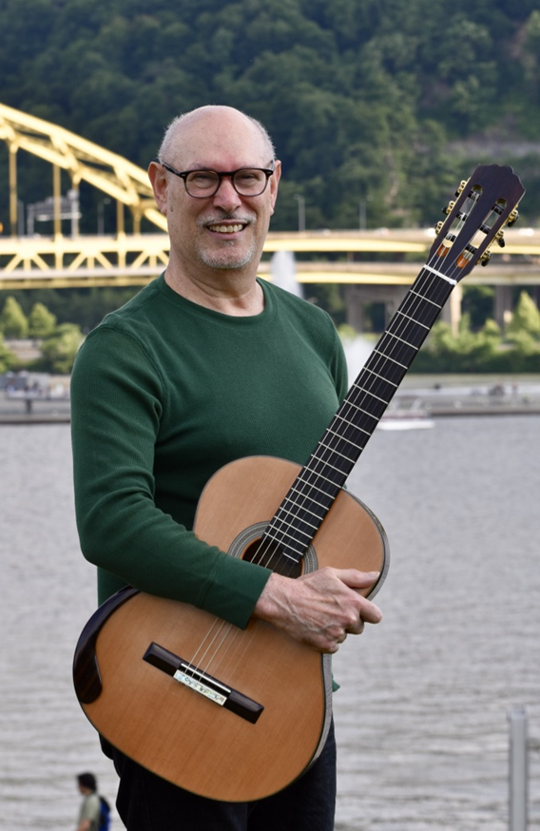
Alex is an eclectic composer who, with his unique musical voice, takes the best from each music style to create his works of art. Because of its quality, expression, and creativity, Alex's music is already part of the Art and popular Venezuelan music history. I very much admire the natural flow of his pieces and the imprint of his musical personality, which ranges from jazz to avant-garde classical music. Alex wrote about his work Mercy:
Alex Rodríguez:
His Music and Life
This waltz has a different aesthetic to those of the Triptych. Although it retains a romantic melos, its harmony suggests a more contemporary trend creating an interesting tonal diversity. Mercy has a different form than the traditional waltz but is rooted in national music roots.
Mercy (3:23)

Slide 6
Alex Rodríguez: His Music and Life

