Slide 1
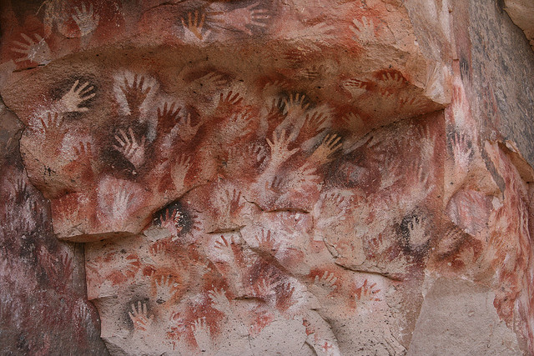
Cueva de las Manos, Santa Cruz Argentina – 13,000 y/o

Slide 2
What do you see?

Slide 3
What can this mean?

Slide 4
What do you see?

Slide 6
Motion?

Slide 7
Why?

Slide 8
Chumash Rock Art, Santa Barbara County, California - 2000 y/o

Slide 9
Western Arnhem, Australia – 20,000 y/o

Slide 10
Cueva Pintada, Baja California – Age?

Slide 11
San Gregorio 1, Baja California

Slide 12
Chauvet Cave, France – 32,000 y/o

Slide 13
Banguedae, Ulsan Korea – 7000 y/o

